Slide 1
Technology and demonstratives in jury trials: how to avoid prosecutorial misconduct
Theresa m. haar
Special assistant attorney general

Slide 2
Duties of a prosecutor
What is prosecutorial misconduct?

Slide 3
Berger v. United States
Prosecutorial misconduct is “overstepp[ing] the bounds of that propriety and fairness which should characterize the conduct of such an officer in the prosecution of a criminal offense.”
285 U.S. 78 (1935)
Notes:
Prosecutorial misconduct occurs when a prosecutor breaks a law or a code of professional ethics in the course of a prosecution. In Berger v. United States, Justice Sutherland described prosecutorial misconduct as “overstepp[ing] the bounds of that propriety and fairness which should characterize the conduct of such an officer in the prosecution of a criminal offense.”

Slide 4
Collier v. State
Prosecutorial misconduct is “a burden to the judicial system that is totally unnecessary and, so far as the prosecution is concerned, often self-defeating.”
101 Nev. 473, 477, 705 P.2d 1126, 1128 (1985)
Notes:
The Nevada Supreme Court described prosecutorial misconduct as “a burden to the judicial system that is totally unnecessary and, so far as the prosecution is concerned, often self-defeating.” Collier v. State, 101 Nev. 473, 477, 705 P.2d 1126, 1128 (1985).

Slide 5
Nevada Rule of Professional
Conduct 3.8
The prosecutor in a criminal case shall:
(a) Refrain from prosecuting a charge that the prosecutor knows is not supported by probable cause;
Special Responsibilities of a Prosecutor
Notes:
The prosecutor in a criminal case shall:
(a) Refrain from prosecuting a charge that the prosecutor knows is not supported by probable cause

Slide 6
Nevada Rule of Professional
Conduct 3.8
The prosecutor in a criminal case shall:
(b) Make reasonable efforts to assure that the accused has been advised of the right to, and the procedure for obtaining, counsel and has been given reasonable opportunity to obtain counsel;
Special Responsibilities of a Prosecutor
Notes:
(b) Make reasonable efforts to assure that the accused has been advised of the right to, and the procedure for obtaining, counsel and has been given reasonable opportunity to obtain counsel;

Slide 7
Nevada Rule of Professional
Conduct 3.8
The prosecutor in a criminal case shall:
(c) Not seek to obtain from an unrepresented accused a waiver of important pretrial rights, such as the right to a preliminary hearing;
Special Responsibilities of a Prosecutor
Notes:
(c) Not seek to obtain from an unrepresented accused a waiver of important pretrial rights, such as the right to a preliminary hearing;

Slide 8
Nevada Rule of Professional
Conduct 3.8
The prosecutor in a criminal case shall:
(d) Make timely disclosure to the defense of all evidence or information known to the prosecutor that tends to negate the guilt of the accused or mitigates the offense, and, in connection with sentencing, disclose to the defense and to the tribunal all unprivileged mitigating information known to the prosecutor, except when the prosecutor is relieved of this responsibility by a protective order of the tribunal;
Special Responsibilities of a Prosecutor
Notes:
(d) Make timely disclosure to the defense of all evidence or information known to the prosecutor that tends to negate the guilt of the accused or mitigates the offense, and, in connection with sentencing, disclose to the defense and to the tribunal all unprivileged mitigating information known to the prosecutor, except when the prosecutor is relieved of this responsibility by a protective order of the tribunal;

Slide 9
Nevada Rule of Professional
Conduct 3.8
The prosecutor in a criminal case shall:
(e) Not subpoena a lawyer in a grand jury or other criminal proceeding to present evidence about a past or present client unless the prosecutor reasonably believes:
(1) The information sought is not protected from disclosure by any applicable privilege;
(2) The evidence sought is essential to the successful completion of an ongoing investigation or prosecution; and
(3) There is no other feasible alternative to obtain the information;
Special Responsibilities of a Prosecutor
Notes:
(e) Not subpoena a lawyer in a grand jury or other criminal proceeding to present evidence about a past or present client unless the prosecutor reasonably believes:
(1) The information sought is not protected from disclosure by any applicable privilege;
(2) The evidence sought is essential to the successful completion of an ongoing investigation or prosecution; and
(3) There is no other feasible alternative to obtain the information;

Slide 10
Nevada Rule of Professional
Conduct 3.8
The prosecutor in a criminal case shall:
(f) Except for statements that are necessary to inform the public of the nature and extent of the prosecutor’s action and that serve a legitimate law enforcement purpose, refrain from making extrajudicial comments that have a substantial likelihood of heightening public condemnation of the accused and exercise reasonable care to prevent investigators, law enforcement personnel, employees or other persons assisting or associated with the prosecutor in a criminal case from making an extrajudicial statement that the prosecutor would be prohibited from making under Rule 3.6 or this Rule.
Special Responsibilities of a Prosecutor
Notes:
(f) Except for statements that are necessary to inform the public of the nature and extent of the prosecutor’s action and that serve a legitimate law enforcement purpose, refrain from making extrajudicial comments that have a substantial likelihood of heightening public condemnation of the accused and exercise reasonable care to prevent investigators, law enforcement personnel, employees or other persons assisting or associated with the prosecutor in a criminal case from making an extrajudicial statement that the prosecutor would be prohibited from making under Rule 3.6 or this Rule.

Slide 11
US v. Harlow
Nevada follows the two-step analysis of US v. Harlow
  First, the Court determines whether the prosecutor’s conduct was improper.
  Second, if the conduct was improper, the Court must determine whether the improper conduct warrants reversal.
    With respect to the second step, the Court will not reverse a conviction based on prosecutorial misconduct if it was harmless error.
444 F.3d 1255, 1265 (10th Cir. 2006)
Notes:
Nevada follows the two-step analysis of US v. Harlow
First, the Court determines whether the prosecutor’s conduct was improper.
Second, if the conduct was improper, the Court must determine whether the improper conduct warrants reversal.
With respect to the second step, the Court will not reverse a conviction based on prosecutorial misconduct if it was harmless error.

Slide 12
Cumulative error

Slide 13
Valdez v. State
124 Nev. 1172, 196 P.3d 465 (2008)

Slide 14
Valdez v. state
Valdez was convicted of first degree murder with a deadly weapon and attempted murder with a deadly weapon.
While the guilt and penalty phases were separate trials, when the jury returned the guilty verdict, it also announced that it had decided his sentence as well. Valdez stipulated to two consecutive life sentences on the murder, and two consecutive terms of 96-240 months on the attempted murder. He reserved his right to appeal the judgment of conviction.
In his appeal, Valdez raised multiple arguments regarding the invalidity of his conviction and sentence. He specifically raised multiple claims of prosecutorial misconduct.
124 Nev. 1172, 196 P.3d 465 (2008)
Notes:
Valdez was convicted of first degree murder with a deadly weapon and attempted murder with a deadly weapon.
While the guilt and penalty phases were separate trials, when the jury returned the guilty verdict, it also announced that it had decided his sentence as well. Valdez stipulated to two consecutive life sentences on the murder, and two consecutive terms of 96-240 months on the attempted murder. He reserved his right to appeal the judgment of conviction.
In his appeal, Valdez raised multiple arguments regarding the invalidity of his conviction and sentence. He specifically raised multiple claims of prosecutorial misconduct. He claimed there was prosecutorial misconduct during jury selection, the opening statement, questioning of an expert witness, and during closing arguments.

Slide 15
Valdez v. State
Jury Selection
  “Okay. Well, I don't think anybody in here, with maybe one exception, would ever think that they should kill kids.”
124 Nev. 1172, 196 P.3d 465 (2008)
Notes:
During vior dire, a potential juror expressed that he didn’t think anyone should ever kill kids. The prosecutor responded “Okay. Well, I don't think anybody in here, with maybe one exception, would ever think that they should kill kids.” The defense objected, which was sustained, and the court instructed the jurors to disregard that statement.
The Court determined that this statement on its own was not a violation of Valdez’s substantial rights, but taken into consideration the cumulative error, reversal was warranted.

Slide 16
Valdez v. State
Opening Statement
  “On that same day, there was a lot of press in this case because a little boy that's 12 years old got stabbed in the chest and he ran out of the apartment. He had a broken piece of the knife stuck in his chest still, and there was a little bit of a man hunt type of thing, so it was in the press. Eventually, he is the one that was apprehended.”
124 Nev. 1172, 196 P.3d 465 (2008)
Notes:
Valdez challenged three statements made during the prosecutor’s opening statement.
“On that same day, there was a lot of press in this case because a little boy that's 12 years old got stabbed in the chest and he ran out of the apartment. He had a broken piece of the knife stuck in his chest still, and there was a little bit of a man hunt type of thing, so it was in the press. Eventually, he is the one that was apprehended.”
The Court determined that the first two comments were not improper – there was pre-trial publicity and it was not improper to refer to the 12-year old victim as a little boy.
The Court determined however that referring to the apprehension of the defendant Valdez as a “man hunt” was improper. The Court determined that the use of the phrase “man hunt” was an attempt to inflame the jury because it was an inaccurate description of the arrest.
Leading up to the arrest of Valdez, law enforcement simply called him on his cell phone, and he was subsequently arrested without resistance or incident.
It was determined that this statement on its own was not a violation of Valdez’s substantial rights, but taken into consideration the cumulative error, reversal was warranted.

Slide 17
Valdez v. State
Description of possible punishments
  There’s two other charges here: Attempt murder and assault with a deadly weapon.
  In the event you find him guilty of that, you would not be sentencing him on that. The Court decides that.
  So those four punishments are the range that you would be determining, and as we’ve kind of alluded to, we have to prove an aggravator or multiple aggravators that are statutorily required.
  There are a lot of first-degree murders out there that we’ll never ever have the opportunity for the death sentence, and the reason why is because there’s no aggravators.
124 Nev. 1172, 196 P.3d 465 (2008)
Notes:
Also during opening, the prosecutor described the possible punishments the jury could impose.
There's two other charges here: Attempt[ed] murder and assault with a deadly weapon.
In the event you find him guilty of that, you would not be sentencing him on that. The [c]ourt decides that.
So those four punishments are the range that you would be determining, and as we've kind of alluded to, we have to prove an aggravator or multiple aggravators that are statutorily required.
There are a lot[ ] of first-degree murders out there that we'll never ever have the opportunity for the death sentence, and the reason why is because there's no aggravators.
--
The Court determined that this statement on its own was not a violation of Valdez’s substantial rights, but taken into consideration the cumulative error, reversal was warranted.

Slide 18
Valdez v. State
Questioning of an expert witness
  The district court prohibited any suggestion that the defense prevented the State's expert witness, forensic psychiatrist Dr. Thomas Bittker, from interviewing Valdez.
124 Nev. 1172, 196 P.3d 465 (2008)
Notes:
The district court prohibited any suggestion that the defense prevented the State's expert witness, forensic psychiatrist Dr. Thomas Bittker, from interviewing Valdez.
During direct examination of Dr. Bittker, the prosecutor asked him to inform the jury about his packet of information on Valdez. In his answer, Dr. Bittker stated that he was not permitted access to Valdez. The defense objected and moved to strike the answer. The district court sustained the objection and instructed the jury to disregard the comment.
During cross-examination of Dr. Bittker, defense counsel elicited testimony that while Dr. Bittker preferred to interview people before making a final assessment, he had not interviewed Valdez, which meant that the defense's expert witness, who had interviewed Valdez, had more information when he made his diagnosis. During redirect examination of Dr. Bittker, the prosecutor inquired, “You asked to do an interview with [Valdez], didn't you?” The defense objected, and the prosecutor argued that the defense brought up the issue on cross-examination. The district court sustained the objection and reminded the jury not to make any adverse inference.
The Court determined that this statement on its own was not a violation of Valdez’s substantial rights, but taken into consideration the cumulative error, reversal was warranted.

Slide 19
Valdez v. State
Closing argument
  Valdez challenges the prosecutor's statement commenting on the defense's theory that S.E. stabbed Valdez in the hand, that “[y]ou know what, he should have got a knife and he should have stabbed it right into the back of…” The defense objected that the comment was inflammatory and should be stricken. The district court sustained the objection, ordered the comment stricken, and instructed the jury to disregard it.
124 Nev. 1172, 196 P.3d 465 (2008)
Notes:
Valdez challenges the prosecutor's statement commenting on the defense's theory that S.E. stabbed Valdez in the hand, that “[y]ou know what, [S.E.] should have got a knife and he should have stabbed it right into the back of—.” The defense objected that the comment was inflammatory and should be stricken. The district court sustained the objection, ordered the comment stricken, and instructed the jury to disregard it.
The Court determined that this statement on its own was not a violation of Valdez’s substantial rights, but taken into consideration the cumulative error, reversal was warranted.

Slide 20
Valdez v. State
Cumulative Error
  When evaluating a claim of cumulative error, the Court must consider the following factors: “(1) whether the issue of guilt is close, (2) the quantity and character of the error, and (3) the gravity of the crime charged.”
124 Nev. 1172, 196 P.3d 465 (2008)
Notes:
The cumulative effect of errors may violate a defendant's constitutional right to a fair trial even though errors are harmless individually.” When evaluating a claim of cumulative error, the Court must consider the following factors: “(1) whether the issue of guilt is close, (2) the quantity and character of the error, and (3) the gravity of the crime charged.”
The court must ensure that harmless-error analysis does not allow prosecutors to engage in misconduct by overlooking cumulative error in cases with substantial evidence of guilt.

Slide 21
Valdez v. State
Holding:
  A reasonable juror could have inferred from all of these comments that Valdez resisted arrest, felt no remorse for harming the child, and should be put to death to compensate for all the other first-degree murderers who will never be put to death.
124 Nev. 1172, 196 P.3d 465 (2008)
Notes:
Ultimately the Nevada Supreme Court considered the cumulative error of the multiple instances of prosecutorial misconduct.
The prosecutorial misconduct was significant and pervasive. The prosecutorial misconduct occurred throughout the trial, including during jury selection, in opening statement, while questioning an expert witness, and in closing.
As a result, a reasonable juror could have inferred from all of these comments that Valdez resisted arrest, felt no remorse for harming the child, and should be put to death to compensate for all the other first-degree murderers who will never be put to death.
Ultimately the Court concluded that taken together and considering the other errors in this trial, the conduct denied Valdez a fair trial. The verdict was reversed and the case was remanded for a new trial.

Slide 22
Use of Demonstrative aids

Slide 23
Allred v. state
120 Nev. 410, 92 P.3d 1246 (2004)
Notes:
Allred v. State is a good example of how to avoid prosecutorial misconduct in the use of demonstrative aids in a jury trial.

Slide 24
Allred v. State
Demonstrative aides are generally permissible in jury trials
120 Nev. 410, 92 P.3d 1246 (2004)
Notes:
Demonstrative aides are generally permissible in jury trials

Slide 25
Allred v. State
This case arose out of a bar fight that took place outside of the Liberty Club in Ely. The defendant claimed that he followed the victim outside to smooth things over after an argument, the victim attempted to punch him, and in response he punched the victim once.
Following a 2–day trial, a jury unanimously convicted appellant Christopher Allred of one count of battery with substantial bodily harm. The district court imposed on Allred the maximum sentence of 60 months with the possibility of parole after 24 months.
120 Nev. 410, 92 P.3d 1246 (2004)
Notes:
This case arose out of a bar fight that took place outside of the Liberty Club in Ely. The defendant claimed that he followed the victim outside to smooth things over after an argument, the victim attempted to punch him, and in response he punched the victim once.
Following a 2–day trial, a jury unanimously convicted appellant Christopher Allred of one count of battery with substantial bodily harm. The district court imposed on Allred the maximum sentence of 60 months with the possibility of parole after 24 months.

Slide 26
Allred v. State
The defense raised on appeal that the prosecutor’s statements during closing arguments amounted to misconduct, particularly in commenting on the defendant’s failure to testify.
The Nevada Supreme Court has held that “as long as a prosecutor's remarks do not call attention to a defendant's failure to testify, it is permissible to comment on the failure of the defense to counter or explain evidence presented.”
120 Nev. 410, 92 P.3d 1246 (2004)
Notes:
The defense raised on appeal that the prosecutor’s statements during closing arguments amounted to misconduct, particularly in commenting on the defendant’s failure to testify.
The Nevada Supreme Court has held that “as long as a prosecutor's remarks do not call attention to a defendant's failure to testify, it is permissible to comment on the failure of the defense to counter or explain evidence presented.”
During closing arguments in the instant case, the prosecutor referred to the two different accounts Allred gave to Deputy Swetich. The prosecutor then said, “Allred doesn't come forth with an accurate account of how this occurred ever.” Allred's attorney failed to object to the prosecutor's statement during closing argument. Failure to object to an issue at trial will generally preclude appellate review of that issue unless there is plain error.

Slide 27
Allred v. State
The defendant also argued that the prosecutor’s demonstrative exhibits used during closing arguments constituted misconduct because the exhibits were irrelevant, highly prejudicial, and not supported by the evidence.
120 Nev. 410, 92 P.3d 1246 (2004)
Notes:
The defendant also argued that the prosecutor’s demonstrative exhibits used during closing arguments constituted misconduct because the exhibits were irrelevant, highly prejudicial, and not supported by the evidence.

Slide 28
Allred v. State
The district court reviewed the State's three proposed demonstrative exhibits outside the presence of the jury.
  The first exhibit included an admitted photograph of the victim’s hands, with the notation “physical evidence of a battery,” and listed the injuries the victim sustained during the altercation.
  The second exhibit included an admitted photograph of the victim’s face, with the “physical evidence of a battery” notation and contained check marks for his facial injuries.
  The third exhibit listed the injuries the victim suffered on the rest of his body.
120 Nev. 410, 92 P.3d 1246 (2004)
Notes:
The district court reviewed the State's three proposed demonstrative exhibits outside the presence of the jury.
The first exhibit included an admitted photograph of the victim’s hands, with the notation “physical evidence of a battery,” and listed the injuries the victim sustained during the altercation.
The second exhibit included an admitted photograph of the victim’s face, with the “physical evidence of a battery” notation and contained check marks for his facial injuries.
The third exhibit listed the injuries the victim suffered on the rest of his body.

Slide 29
Allred v. State
The district court sustained the objection by the defendant’s counsel, finding:
  The notations, “physical evidence of a battery,” were argumentative and ordered the prosecutor to remove them from the three exhibits.
  The third exhibit must be altered to properly reflect the victim’s injuries.
  The prosecutor must remove the notation “post battery injuries” from the third exhibit, as well as the comparison between the defendant’s injuries to the victim’s injuries.
120 Nev. 410, 92 P.3d 1246 (2004)
Notes:
After Allred's attorney objected that the demonstrative exhibits' content was prejudicial, the district court thoroughly examined each exhibit. The district court concluded that the notations, “physical evidence of a battery,” were argumentative and ordered the prosecutor to remove them from the three exhibits.
Additionally, the district court ordered the third exhibit altered to properly reflect the victim’s injuries. The district court also ordered the prosecutor to remove the notation “post battery injuries” from the third exhibit, as well as the comparison between the defendant’s injuries to the victim’s injuries.
Apart from those changes, the district court indicated that the exhibits were consistent with the testimony and the pictures had already been admitted into evidence.
The Supreme Court determined that because the exhibits used during closing argument, as edited, were proper, there was no prosecutorial misconduct.

Slide 30
Allred v. State
The use of demonstrative aides is appropriate so long as the aides do not misrepresent the evidence introduced at trial.
It is important to remember that a demonstrative may not be used to make an argument visually that would be improper if made orally.
120 Nev. 410, 92 P.3d 1246 (2004)
Notes:
The holding of the Allred case is that the use of demonstrative aides is appropriate so long as the aides do not misrepresent the evidence introduced at trial. It is important to remember that a demonstrative may not be used to make an argument visually that would be improper if made orally.

Slide 31
Use of powerpoint

Slide 32
In utilizing PowerPoint presentations, prosecutors should always ensure that their presentations:
  Contain only images that have been admitted into evidence during the trial;
  Contain unaltered images;
  Provide information which merely summarizes evidence presented;
  Do not demonstrate the prosecutor’s personal opinion;
  Do not have language that obviates the presumption of innocence; and
  Do not misstate the applicable law
Notes:
In utilizing PowerPoint presentations, prosecutors should always ensure that their presentations:
Contain only images that have been admitted into evidence during the trial;
Contain unaltered images;
Provide information which merely summarizes evidence presented;
Do not demonstrate the prosecutor’s personal opinion;
Do not have language that obviates the presumption of innocence; and
Do not misstate the applicable law

Slide 33
Some common bases for misconduct in using PowerPoint presentations
  Oversimplification of legal instructions
  Insertion of a prosecutor’s personal opinion
  Inclusion of materials not in evidence
  Improper comments on a defendant’s constitutional rights
Notes:
Some common bases for misconduct in using PowerPoint presentations
Oversimplification of legal instructions
Insertion of a prosecutor’s personal opinion
Inclusion of materials not in evidence
Improper comments on a defendant’s constitutional rights

Slide 34
Watters v. State
129 Nev. 886, 313 P.3d 243 (2013)

Slide 35
Watters v. State
Frankie Alan Watters was charged with and convicted of possession of a stolen vehicle, grand larceny of a vehicle, and failure to stop on the signal of a police officer. The charges grew out of a crime spree in which Watters allegedly stole a car, got in a wreck, fled, stole another car, became involved in a high-speed chase, ditched the second car, ran into a store, and was finally arrested after being knocked to the ground and bitten several times in the leg by a police dog.
129 Nev. 886, 313 P.3d 243 (2013)
Notes:
Frankie Alan Watters was charged with and convicted of possession of a stolen vehicle, grand larceny of a vehicle, and failure to stop on the signal of a police officer. The charges grew out of a crime spree in which Watters allegedly stole a car, got in a wreck, fled, stole another car, became involved in a high-speed chase, ditched the second car, ran into a store, and was finally arrested after being knocked to the ground and bitten several times in the leg by a police dog.

Slide 36
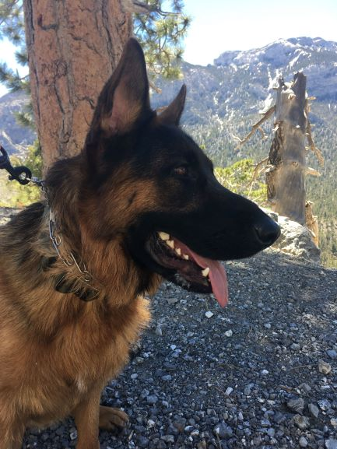
Watters v. State
Notes:
This is not the k-9 in question. This is my puppy, Trooper.

Slide 37
Watters v. State
At trial, the State used a PowerPoint to support its opening statement to the jury. The presentation included a slide showing the defendant’s booking photo with the word “GUILTY” written across his battered face.
129 Nev. 886, 313 P.3d 243 (2013)

Slide 38
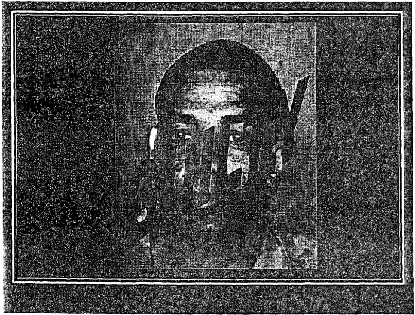
Watters v. State

Slide 39
Watters v. State
Opening Statements
  The purpose of the opening statement is to acquaint the jury and the court with the nature of the case.
  In a criminal case, the prosecutor's opening statement should be confined to a statement of the issues in the case and the evidence the prosecutor intends to offer which the prosecutor believes in good faith will be available and admissible.
  It is not an opportunity to poison the jury's mind against the defendant or to recite items of highly questionable evidence.
129 Nev. 886, 313 P.3d 243 (2013)

Slide 40
Watters v. State
A prosecutor may use PowerPoint slides to support his or her opening statement so long as the slides' content is consistent with the scope and purpose of opening statements and does not put inadmissible evidence or improper argument before the jury.
But a PowerPoint may not be used to make an argument visually that would be improper if made orally.
129 Nev. 886, 313 P.3d 243 (2013)

Slide 41
Watters v. State
The prosecution could not orally declare the defendant guilty in opening statement. Doing so would amount to improper argument and the expression of personal opinion on the defendant's guilt, which is forbidden.
See Collier v. State, 101 Nev. 473, 480, 705 P.2d 1126, 1130 (1985) (a prosecutor should not express her personal opinion on the defendant's guilt; “[b]y stepping out of the prosecutor's role, which is to seek justice, and by invoking the authority of ... her own supposedly greater experience and knowledge, a prosecutor invites undue jury reliance on the conclusions personally endorsed by the prosecuting attorney”).
129 Nev. 886, 313 P.3d 243 (2013)
Notes:
Here, the prosecutor orally declared that she would be asking the jurors to find Watters guilty. But the PowerPoint that accompanied her declaration displayed Watters's booking photograph with a pop-up that directly labeled him “GUILTY.” The Court determined that these are not just two different ways of saying the same thing. While the oral statement told the jurors that they could expect the prosecutor to ask for a guilty verdict at the end of the trial, the PowerPoint slide directly declared the defendant guilty.
The prosecution could not orally declare the defendant guilty in opening statement. Doing so would amount to improper argument and the expression of personal opinion on the defendant's guilt, which is forbidden.
See Collier v. State, 101 Nev. 473, 480, 705 P.2d 1126, 1130 (1985) (a prosecutor should not express her personal opinion on the defendant's guilt; “[b]y stepping out of the prosecutor's role, which is to seek justice, and by invoking the authority of ... her own supposedly greater experience and knowledge, a prosecutor invites undue jury reliance on the conclusions personally endorsed by the prosecuting attorney”).
Ultimately, the Supreme Court determined that there was a question of whether the PowerPoint sequence deeming the defendant guilty affected the jury’s determination of guilt. Accordingly, the conviction was reversed and remanded for a new trial.

Slide 42
Watters v. State
In its holding, the Court stressed the impact of visual aids on a jury, “[w]ith visual information, people believe what they see and will not step back and critically examine the conclusions they reach, unless they are explicitly motivated to do so.”
129 Nev. 886, 313 P.3d 243 (2013)
Notes:
In its holding, the Court stressed the impact of visual aids on a jury, “[w]ith visual information, people believe what they see and will not step back and critically examine the conclusions they reach, unless they are explicitly motivated to do so.”

Slide 43
State v. Salas
408 P.3d 383 (Wash. Ct. App. 2018)

Slide 44
State v. Salas
Encarnacion Salas was charged with the second degree murder of an individual who was described in court as Salas’ good friend.
Salas claimed self-defense.
408 P.3d 383 (Wash. Ct. App. 2018)
Notes:
In that case, Encarnacion Salas was charged with the second degree murder of an individual who was described in court as Salas’s good friend. On the night of Lopez’s death, Salas had a knife he routinely carried in his backpack when he visited Lopez’s apartment, which the decedent shared with his mother. According to Salas, the pair went out on a balcony to smoke when Lopez attempted to make a sexual pass at Salas. After Salas yelled at him, Lopez attacked him with Salas’s own knife. A physical altercation ensued, with Lopez ending up with 15 knife wounds and dying on the kitchen floor. Salas claimed self-defense.

Slide 45
State v. Salas
At closing, the prosecutor displayed a 22-slide PowerPoint presentation, which had not been previously shared with the court or with the defendant’s counsel.
408 P.3d 383 (Wash. Ct. App. 2018)
Notes:
At closing, the prosecutor displayed a 22-slide PowerPoint presentation, which had not been previously shared with the court or with the defendant’s counsel.
As a matter of best practices, it is always preferable to disclose your powerpoint used in opening or closing with opposing counsel and the court. That way any objections can be dealt with outside the presence of the jury, which will lower any likelihood of a finding of misconduct. This is a situation that you want to ask for permission, not forgiveness. Which is exactly what we saw in the Allred case, that we discussed earlier.

Slide 46
State v. Salas
The first slide contained two pictures.
  The picture on the right was a picture of Lopez at an amusement park. He was photographed crouched down in front of three characters dressed as Smurfs. A caption about the photo reads, “Jesse Lopez: 5’5.5”, Band leader, saxophone player, customer service representative.”
  The second picture is an unsmiling picture of Salas from his driver’s license. It is captioned “EJ Salas: 5’11”, Football player, fighter, outdoorsman.”
  The prosecutor claimed this was in an attempt to defeat the self-defense claim by highlighting the differences between the physical capabilities of the defendant and the deceased. However, the prosecutor also failed to note that the two men weighed approximately the same.
408 P.3d 383 (Wash. Ct. App. 2018)
Notes:
The first slide contained two pictures.
The picture on the right was a picture of Lopez at an amusement park. He was photographed crouched down in front of three characters dressed as Smurfs. A caption about the photo reads, “Jesse Lopez: 5’5.5”, Band leader, saxophone player, customer service representative.”
The second picture is an unsmiling picture of Salas from his driver’s license. It is captioned “EJ Salas: 5’11”, Football player, fighter, outdoorsman.”
The prosecutor claimed this was in an attempt to defeat the self-defense claim by highlighting the differences between the physical capabilities of the defendant and the deceased. However, the prosecutor also failed to note that the two men weighed approximately the same.

Slide 47
State v. Salas
Notes:
This was the slide used in closing, claiming to highlight the size difference, which would negate a claim of self-defense.

Slide 48
Notes:
After showing slides featuring multiple gruesome crime scene photos and photos of Lopez’s bloody body, the prosecutor ended his PowerPoint with a photo of the victim smiling and embracing a friend on a Ferris Wheel. The prosecutor left that photo up for at least a minute while making the last of the closing arguments.

Slide 49
State v. Salas
Closing argument provides an opportunity for counsel to summarize and highlight relevant evidence and argue reasonable inferences from the evidence.
PowerPoint slides can be improper and prejudicial even if they do not number in the hundreds and do not shout “GUILTY GUILTY GUILTY!” in red letters.
The Washington Court concluded there was a substantial likelihood that the visual presentation prejudiced the defendant’s right to a trial in which his claim of self-defense and the alternative of manslaughter could be fairly considered, and ordered a new trial.
408 P.3d 383 (Wash. Ct. App. 2018)
Notes:
Closing argument provides an opportunity for counsel to summarize and highlight relevant evidence and argue reasonable inferences from the evidence. Multimedia tools such as PowerPoint presentations offer an effective and engaging method of communicating such information to the jury. But a prosecutor’s freedom in using such tools is not without limits. Prosecutors have a “duty to ‘subdue courtroom zeal,’ not to add to it, in order to ensure the defendant receives a fair trial.”
In evaluating the photos, the Court stated that it was not improper for the prosecutor to remind the jury that Salas was taller than Lopez. Relative size, strength, and age of the individuals involved is relevant in a self-defense case. But if the purpose of the slide was to compare them in size, the photographs are not helpful. The photograph of Salas shows only his head. And the caption does not mention the fact that the two men were roughly equivalent in weight.
The captions reinforce the visual contrast. They evoke high school stereotypes. Lopez was a musician, whereas Salas played football and was once in a fight club. Which type of person was more likely to initiate a fight?
PowerPoint slides can be improper and prejudicial even if they do not number in the hundreds and do not shout “GUILTY GUILTY GUILTY!” in red letters.
The Washington Court concluded there was a substantial likelihood that the visual presentation prejudiced the defendant’s right to a trial in which his claim of self-defense and the alternative of manslaughter could be fairly considered, and ordered a new trial.

Slide 50
State v. Walker
341 P.3d 976 (Wash. 2015)

Slide 51
State v. Walker
Odies Walker was convicted as an accomplice to first degree murder, first degree assault, first degree robbery, solicitation, and conspiracy.
341 P.3d 976 (Wash. 2015)
Notes:
Odies Walker was convicted as an accomplice to first degree murder, first degree assault, first degree robbery, solicitation, and conspiracy.

Slide 52
State v. Walker
The prosecutor’s closing argument repeatedly expressed the prosecutor's personal opinion on guilt—over 100 of its approximately 250 slides were headed with the words “DEFENDANT WALKER GUILTY OF PREMEDITATED MURDER,” and one slide showed Walker's booking photograph altered with the words “GUILTY BEYOND A REASONABLE DOUBT,” which were superimposed over his face in bold red letters.
341 P.3d 976 (Wash. 2015)
Notes:
The primary question in this case is whether those convictions must be reversed in light of the PowerPoint presentation the prosecuting attorney used during closing argument. That presentation repeatedly expressed the prosecutor's personal opinion on guilt—over 100 of its approximately 250 slides were titled with the words “DEFENDANT WALKER GUILTY OF PREMEDITATED MURDER,” and one slide showed Walker's booking photograph altered with the words “GUILTY BEYOND A REASONABLE DOUBT,” which were superimposed over his face in bold red letters.

Slide 53
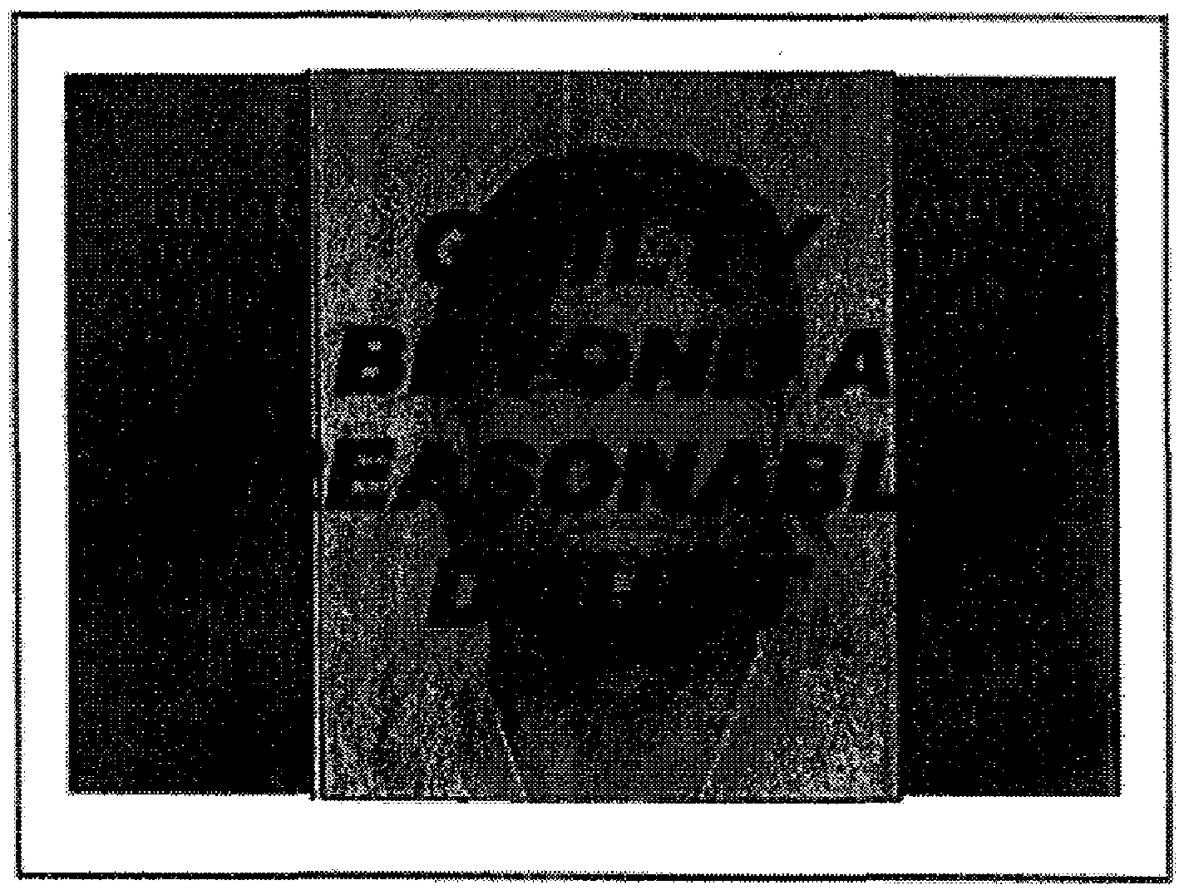
State v. Walker

Slide 54
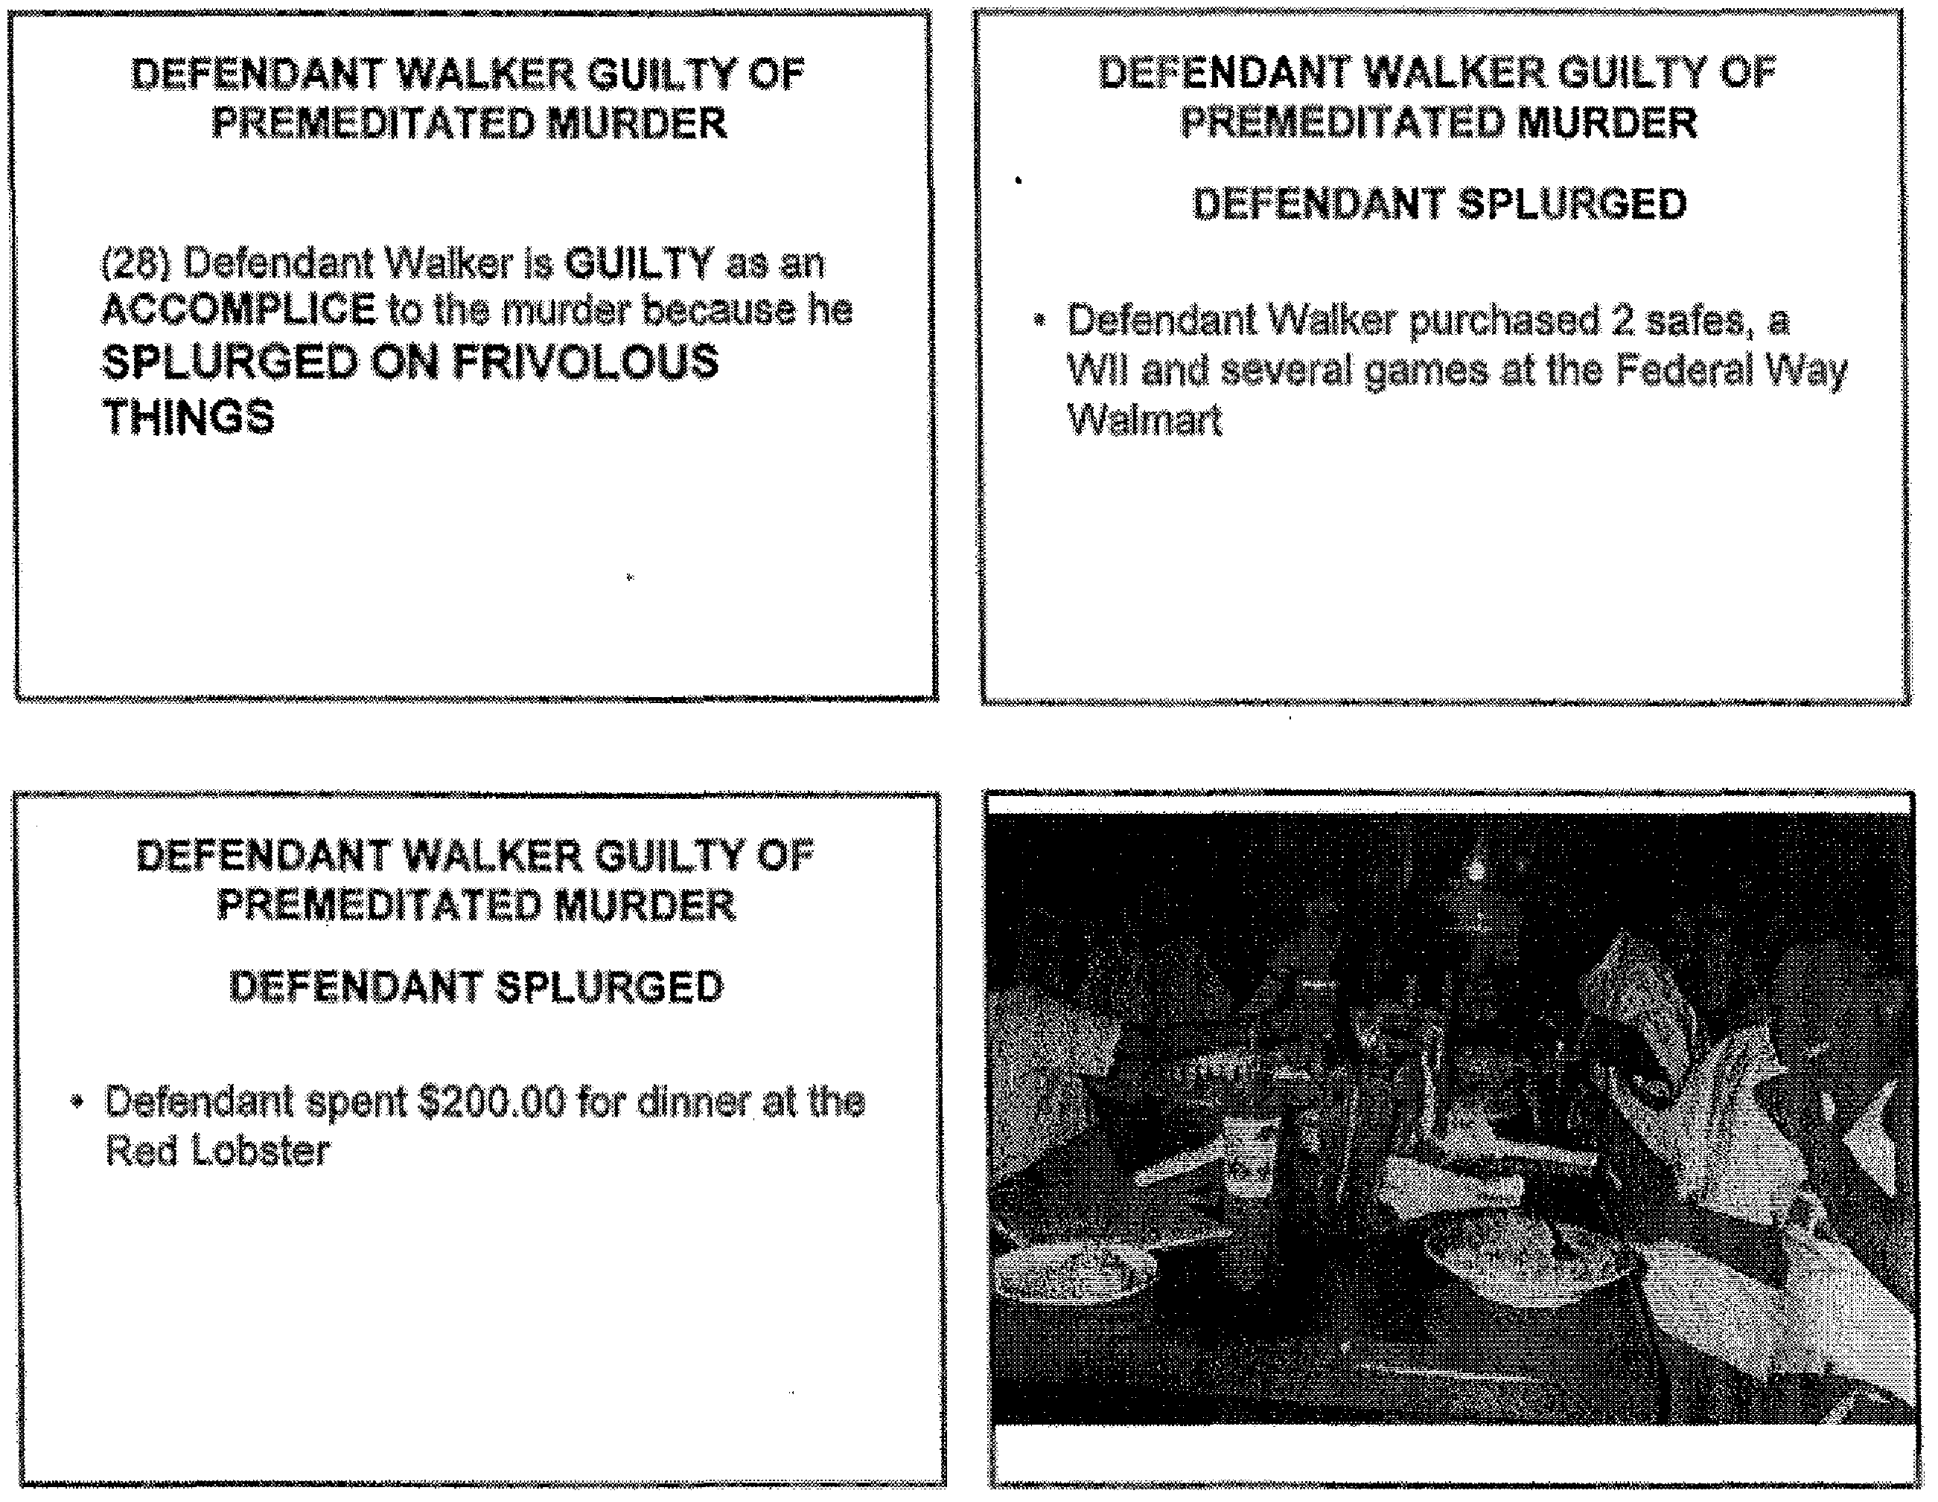
State v. walker

Slide 55
State v. walker

Slide 56
State v. walker

Slide 57
State v. walker
Notes:
Several other slides included photographs that were admitted exhibits, but altered with captions, headings, and superimposed text. For example, one slide is a photograph of money seized by police with the heading “MONEY IS MORE IMPORTANT THAN HUMAN LIFE” even though there was never an allegation or evidence that the defendant, or anyone else involved, ever actually said those words.

Slide 58
State v. Walker
Several other slides include photographs that were admitted exhibits, but altered with captions, headings, and superimposed text. For example, one slide is a photograph of money seized by police with the heading “MONEY IS MORE IMPORTANT THAN HUMAN LIFE” even though there was never an allegation or evidence that the defendant, or anyone else involved, ever actually said those words.
341 P.3d 976 (Wash. 2015)
Notes:
Odies Walker was convicted as an accomplice to first degree murder, first degree assault, first degree robbery, solicitation, and conspiracy. The primary question in this case is whether those convictions must be reversed in light of the PowerPoint presentation the prosecuting attorney used during closing argument. That presentation repeatedly expressed the prosecutor's personal opinion on guilt—over 100 of its approximately 250 slides were headed with the words “DEFENDANT WALKER GUILTY OF PREMEDITATED MURDER,” and one slide showed Walker's booking photograph altered with the words “GUILTY BEYOND A REASONABLE DOUBT,” which were superimposed over his face in bold red letters.
Several other slides include photographs that were admitted exhibits, but altered with captions, headings, and superimposed text. For example, one slide is a photograph of money seized by police with the heading “MONEY IS MORE IMPORTANT THAN HUMAN LIFE” even though there was never an allegation or evidence that the defendant, or anyone else involved, ever actually said those words.

Slide 59
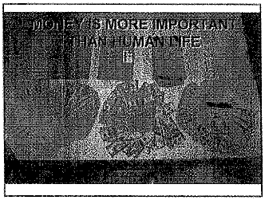
State v. walker
Notes:
Several other slides included photographs that were admitted exhibits, but altered with captions, headings, and superimposed text. For example, one slide is a photograph of money seized by police with the heading “MONEY IS MORE IMPORTANT THAN HUMAN LIFE” even though there was never an allegation or evidence that the defendant, or anyone else involved, ever actually said those words.

Slide 60
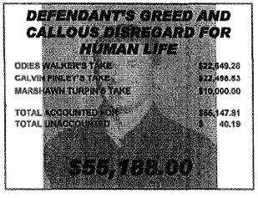
State v. Walker
Notes:
The prosecutor also appealed to passion and prejudice by juxtaposing photographs of the victim with photographs of Walker and his family, some altered with the addition of inflammatory captions and superimposed text. While the prosecutor is entitled to draw the jury's attention to admitted evidence, those slides, as presented, served no legitimate purpose. Their prejudicial effect could not have been cured by a timely objection, and the court cannot conclude with any confidence that the defendant’s convictions were the result of a fair trial.

Slide 61
State v. Walker
The prosecutor appealed to passion and prejudice by juxtaposing photographs of the victim with photographs of Walker and his family, some altered with the addition of inflammatory captions and superimposed text.
While the prosecutor is entitled to draw the jury's attention to admitted evidence, those slides, as presented, served no legitimate purpose.
Their prejudicial effect could not have been cured by a timely objection, and the court cannot conclude with any confidence that the defendant’s convictions were the result of a fair trial.
341 P.3d 976 (Wash. 2015)
Notes:
The prosecutor appealed to passion and prejudice by juxtaposing photographs of the victim with photographs of Walker and his family, some altered with the addition of inflammatory captions and superimposed text.
While the prosecutor is entitled to draw the jury's attention to admitted evidence, those slides, as presented, served no legitimate purpose.
Their prejudicial effect could not have been cured by a timely objection, and the court cannot conclude with any confidence that the defendant’s convictions were the result of a fair trial.

Slide 62
Other examples of prosecutorial misconduct arising from improper PowerPoint slides

Slide 63
State v. Walter
The Missouri court held that the act of digitally imposing the word “GUILTY” across the mugshot of the defendant was prejudicial.
479 S.W.3d 118 (Mo. 2016)
Notes:
In the case of State v. Walter, the Missouri Court held that the act of digitally imposing the word “GUILTY” across the booking photo of the defendant was prejudicial.

Slide 64
State v. Mercer
The Ohio court reviewed the trial court’s decision in a case in which the defendant was on trial for the rape of a child and gross imposition of a child younger than 13 years old. In summarizing the state’s case, the prosecutor displayed a slide depicting a block-form man with horns holding the hand of a block-form little girl.
The court agreed with the defendant that depicting the defendant as the devil was “egregious” and flagrantly overstepped “the bounds of professionalism and decorum.”
2103 Ohio App. LEXIS 1414
Notes:
In State v. Mercer, the Ohio Court reviewed the trial court’s decision in a case in which the defendant was on trial for the rape of a child and gross imposition of a child younger than 13 years old. In summarizing the state’s case, the prosecutor displayed a slide depicting a stick-figure man with horns holding the hand of a stick figure little girl.
The court agreed with the defendant that depicting the defendant as the devil was “egregious” and flagrantly overstepped “the bounds of professionalism and decorum.”

Slide 65
State v. Reineke
The Oregon court found that the prosecutor’s slide presentation constituted a comment upon the defendant’s constitutional right to remain silent.
337 P.3d 941 (Or. Ct. App. 2014)
Notes:
In State v. Reineke, the Oregon court found that the prosecutor’s slide presentation constituted a comment upon the defendant’s constitutional right to remain silent.
The Oregon Court of Appeals vacated a murder conviction, holding that a prosecutor’s PowerPoint presentation impermissibly commented on a Defendant’s invocation of his right to remain silent.
Michael Reineke called 911, requesting police and a coroner. When police arrived, they found Reineke’s mother, “lying in her kitchen with a pool of blood around her head and a phone cord around her neck.”
Reineke declined to talk and invoked his right to counsel. He was charged with murder and a jury trial was held.
During closing arguments, the prosecutor used a PowerPoint presentation that included three slides of Reineke’s photograph with the word “GUILTY” in large red capital letters underneath it. One of the slides listed four reasons the jury should find him guilty, including “His refusal to speak at the police station,” positioned directly beneath the word “GUILTY.”
When the prosecutor orally commented on Reineke’s refusal to speak to police, defense counsel objected but the trial court overruled the objection.
The prosecutor discussed each of her four reasons Reineke was guilty, repeatedly commenting on his refusal to speak to police. The court again overruled defense counsel’s objections to the comments and PowerPoint presentation.
“All told, in three separate frames of the PowerPoint presentation, the jury saw ‘His refusal to speak at the police station’ with an arrow pointing to ‘GUILTY.’”

Slide 66
Using Demonstrative aids

Slide 67
Sevier v. State
435 P.3d 1230 (March 15, 2019)

Slide 68
Sevier v. State
Use of a demonstrative aid in closing argument must correctly state the law and must correctly summarize evidence admitted during trial.
Misrepresenting evidence during closing is prosecutorial misconduct constituting reversible error.
435 P.3d 1230 (March 15, 2019)
Notes:
Use of a demonstrative aid in closing argument must correctly state the law and must correctly summarize evidence admitted during trial.
Misrepresenting evidence during closing is prosecutorial misconduct constituting reversible error.

Slide 69
Sevier v. State
Alexander Sevier was convicted of burglarizing two separate businesses, wherein he utilized a firearm to detain and rob one victim and attempt to rob two others. The district court adjudicated Sevier as a violent habitual criminal with respect to three of the convictions and as a large habitual criminal with respect to the remaining convictions, imposing an aggregate sentence of life in prison with the possibility of parole after 12 years.
435 P.3d 1230 (March 15, 2019)
Notes:
Alexander Sevier was convicted of burglarizing two separate businesses, wherein he utilized a firearm to detain and rob one victim and attempt to rob two others. The district court adjudicated Sevier as a violent habitual criminal with respect to three of the convictions and as a large habitual criminal with respect to the remaining convictions, imposing an aggregate sentence of life in prison with the possibility of parole after 12 years.
Sevier challenged his conviction claiming prosecutorial misconduct in misstating DNA evidence during closing.

Slide 70
Sevier v. State
During one of the burglaries, the perpetrator covered his face with three layers of clothing—a maroon scarf; a red, white, and pink-striped scarf; and a blue skirt.
The State’s DNA expert testified that each of these items contained a mixture profile of DNA but that a major DNA contributor could be identified only from the DNA obtained from the skirt, which matched Sevier. As to the two scarves, however, the expert testified that the DNA analysis was inconclusive.
The expert reiterated this conclusion multiple times, once stating, “[f]or these particular two items, no major contributor could have been conclusively determined,” and another time testifying, “for those two [scarves], the data was just so complex, and there was way too much information there for me to apply any of our deconvolution or unraveling of that profile to see if a major contributor could be there.”
435 P.3d 1230 (March 15, 2019)
Notes:
During one of the burglaries, the perpetrator covered his face with three layers of clothing—a maroon scarf; a red, white, and pink-striped scarf; and a blue skirt. The State’s DNA expert testified that each of these items contained a mixture profile of DNA but that a major DNA contributor could be identified only from the DNA obtained from the skirt, which matched Sevier. As to the two scarves, however, the expert testified that the DNA analysis was inconclusive. The expert reiterated this conclusion multiple times, once stating, “[f]or these particular two items, no major contributor could have been conclusively determined,” and another time testifying, “for those two [scarves], the data was just so complex, and there was way too much information there for me to apply any of our deconvolution or unraveling of that profile to see if a major contributor could be there.”

Slide 71
Sevier v. State
Despite the conclusions of the state’s expert, the prosecutor argued during closing “I’ve prepared a demonstrative aid that I’m going to use which combines the mixture profiles of the scarf — the striped scarf and the maroon scarf next to the defendant’s known profile. He’s not excluded from these mixtures because all of the numbers present in his known profile are contained within that mixture. The defendant’s DNA was on all three of those items.”
435 P.3d 1230 (March 15, 2019)
Notes:
Despite the conclusions of the state’s expert, the prosecutor argued during closing “I’ve prepared a demonstrative aid that I’m going to use which combines the mixture profiles of the scarf — the striped scarf and the maroon scarf next to the defendant’s known profile. He’s not excluded from these mixtures because all of the numbers present in his known profile are contained within that mixture. The defendant’s DNA was on all three of those items.”

Slide 72
Sevier v. State
The Court held that State misrepresented the DNA evidence by both incorrectly characterizing it as non-exclusion evidence, rather than inconclusive, and in directly contradicting its expert’s testimony as to the analysis of the DNA on the two scarves, which was clearly improper.
The Court also considered the nature of the evidence that the State misrepresented – DNA evidence, which is highly revered and relied upon by juries as it provides powerful new evidence unlike anything known before.
435 P.3d 1230 (March 15, 2019)
Notes:
The Court held that State misrepresented the DNA evidence by both incorrectly characterizing it as non-exclusion evidence, rather than inconclusive, and in directly contradicting its expert’s testimony as to the analysis of the DNA on the two scarves, which was clearly improper.
The Court also held that it was further improper for the State to reinforce its intentional misrepresentation with a demonstrative aid during closing, circling numbers for the jury, and then state that the defendant’s DNA was present on both scarves, when that was in direct contradiction with the expert’s testimony.
The Court also considered the nature of the evidence that the State misrepresented – DNA evidence, which is highly revered and relied upon by juries as it provides powerful new evidence unlike anything known before.

Slide 73
Morgan v. State
Reiterating the “fundamental legal and ethical rule” that the State may not argue facts not in evidence
134 Nev., Adv. Op. 27, 416 P.3d 212, 227 (2018)
Notes:
Reiterating the “fundamental legal and ethical rule” that the State may not argue facts not in evidence

Slide 74
Yates v. State
Concluding that it is clearly improper for the prosecutor to transform into an unsworn witness during final argument
103 Nev. 200, 205, 734 P.2d 1252, 1255 (1987)
Notes:
Concluding that it is clearly improper for the prosecutor to transform into an unsworn witness during final argument

Slide 75
Schrader v. State
Reversing a criminal conviction based on a prosecutor’s persistence in repeating an improper remark regarding facts not in evidence
102 Nev. 64, 65, 714 P.2d 1008, 1009 (1986)
Notes:
Reversing a criminal conviction based on a prosecutor’s persistence in repeating an improper remark regarding facts not in evidence

Slide 76
Impact of prosecutorial misconduct

Slide 77
Reversal of conviction
Dismissal of charges
Disciplinary sanctions
Monetary damages
Notes:
Reversal of conviction
Dismissal of charges
Disciplinary sanctions
Monetary damages

Slide 78
Sparks v. State
104 Nev. 316, 759 P.2d 180 (1988)

Slide 79
Sparks v. state
The Defense’s theory of the case was that she had killed in self-defense and/or as a result of temporary insanity. The day after the discovery of Ralph Sparks' body, and subsequent to appellant's initial denial of any involvement in the homicide, appellant confessed to killing her father in self-defense. Appellant then gave a statement to the police, which was consistent with her testimony at trial. She testified to her father's acts of physical and sexual abuse which began when she was just eight years old.
104 Nev. 316, 759 P.2d 180 (1988)
Notes:
The Defense’s theory of the case was that she had killed her father in self-defense and/or as a result of temporary insanity. The day after the discovery of Ralph Sparks' body, and subsequent to the defendant’s initial denial of any involvement in the homicide, the defendant confessed to killing her father in self-defense. She then gave a statement to the police, which was consistent with her later testimony at trial. She testified to her father's acts of physical and sexual abuse which began when she was just eight years old.
She further testified that on Saturday, March 2, her father broke through her bedroom door with gun in hand, but the defendant was able to defend herself. The following day, she was waiting for her father to come home so that he could drive her to work. When he arrived he was drunk and entered her bedroom carrying the gun. He put the gun to her head, he held her down and ordered her to undress, threatening to "blow [her] head off" if she did not comply. She testified that they wrestled to the floor where her father hit her in the face with the gun. She, however, was able to run to the living room, but her father pursued her, cocked the gun (which he had done before), and threatened to kill her if she did not return to the bedroom.
In response, the defendant claimed she picked up a tire iron which was leaning against a nearby chair and hit him in the head with it. While he was on the floor, she picked up the gun he had dropped in the hallway, and hid it in a closet.

Slide 80
Sparks v. state
After the shooting, the police found a loaded gun at the crime scene in the master bedroom closet. The police visually examined the gun, the gun was booked into evidence, but no testing was performed on the gun. Then, weeks later, police released the gun to the victim’s son. The gun was re-booked into evidence 6 months later.
104 Nev. 316, 759 P.2d 180 (1988)
Notes:
After the shooting, the police found a loaded gun at the crime scene in the master bedroom closet. The police visually examined the gun, the gun was booked into evidence, but no testing was performed on the gun. Then, weeks later, police released the gun to the victim’s son. The gun was re-booked into evidence 6 months later. This broke the chain of custody.

Slide 81
Sparks v. state
A conviction may be reversed when the State loses evidence if (1) the defendant is prejudiced by the loss or, (2) the evidence was “lost” in bad faith by the government.
104 Nev. 316, 759 P.2d 180 (1988)
Notes:
A conviction may be reversed when the State loses evidence if (1) the defendant is prejudiced by the loss or, (2) the evidence was “lost” in bad faith by the government.

Slide 82
Sparks v. state
The Supreme Court determined that blood, hair, or fingerprints if found on the weapon would have been critical, corroborative evidence supporting the defendant’s testimony that the shooting was in self-defense.
This is especially true where the prosecutor stated both during opening and closing, that the lack of blood and fingerprints on the gun demonstrated that the gun was not used and could not support a theory of self-defense.
104 Nev. 316, 759 P.2d 180 (1988)
Notes:
The Nevada Supreme Court determined that Blood, hair, or fingerprints if found on the weapon would have been critical, corroborative evidence supporting the defendant’s testimony that the shooting was in self-defense.
This is especially true where the prosecutor stated both during opening and closing, that the lack of blood and fingerprints on the gun affirmatively demonstrated that the gun was not used and could not support a theory of self-defense.

Slide 83
Sparks v. state
Ultimately, the Supreme Court determined, not only would the loss of such evidence be prejudicial, but the State buttressed its case by the absence of that evidence.
As the State's action cannot be corrected, the Court held that the conviction must be reversed, all charges dismissed, and the defendant could not be retried.
104 Nev. 316, 759 P.2d 180 (1988)
Notes:
Ultimately, the Nevada Supreme Court determined, not only would the loss of such evidence be prejudicial, but the State buttressed its case by the absence of that evidence. As the State's action cannot be corrected, the Court held that the conviction must be reversed, all charges dismissed, and the defendant could not be retried.

Slide 84
Sevier v. state
435 P.3d 1230 (March 15, 2019)

Slide 85
Sevier v. state
In addition to reversing the conviction, the Nevada Supreme Court referred the prosecutor to the Nevada State Bar for investigation of possible attorney misconduct.
435 P.3d 1230 (March 15, 2019)
Notes:
We previously went through this case as an example of using a demonstrative exhibit to misstate evidence.
In its decision, the Nevada Supreme Court reversed the conviction. The Court also made the determination to refer that prosecutor to the State Bar for investigation of possible attorney misconduct.

Slide 86
Monetary sanctions

Slide 87
Harris County, texas
In a misdemeanor DUI trial, the defense attorney requested records pertaining to the arresting officer’s disciplinary history. The prosecutor refused to turn the information over, and even after a court order compelling the production of the records, the prosecutor refused to do so without a protective order and producing the records under seal.
The judge issued a $500 sanction against the District Attorney’s Office for failure to produce records in compliance with the Court’s order.
Notes:
In a misdemeanor DUI trial, the defense attorney requested records pertaining to the arresting officer’s disciplinary history.
The prosecutor refused to turn the information over, and even after a court order compelling the production of the records, the prosecutor refused to do so without a protective order and producing the records under seal.
The judge issued a $500 sanction against the District Attorney’s Office for failure to produce records in compliance with the Court’s order. The judge also precluded the officer’s testimony at trial.

Slide 88
Filler v. hancock county
After two separate trials, and two appeals, the defendant was deemed to be legally innocent of sexual assault charges. The charge of assault was also dismissed based on prosecutorial misconduct.
Six years after the original arrest, the prosecutor in Filler’s cases admitted to the Maine Supreme Court that she violated the rules of professional conduct during the 2009 criminal trial by withholding exculpatory evidence.
The prosecutor was suspended from the practice of law.
The defendant later filed a civil action against the DA’s Office and the Police Department claiming wrongful prosecution. The State settled for $375,000.
District of Maine
Notes:
After two separate trials, and two appeals, the defendant was deemed to be legally innocent of sexual assault charges. The charge of assault was also dismissed based on prosecutorial misconduct.
Six years after the original arrest, the prosecutor in Filler’s cases admitted to the Maine Supreme Court that she violated the rules of professional conduct during the 2009 criminal trial by withholding exculpatory evidence.
The prosecutor was suspended from the practice of law.
The defendant later filed a civil action against the DA’s Office and the Police Department claiming wrongful prosecution. The State settled for $375,000.

